Slide 1


Economic Analysis: U.S. States since the 2008 Recession

Slide 2
1. Determine which states were the most/least affected by the 2008 Recession and which recovered the best/worst 2. Test factors that we think correlate with the most/least affected states.
Objective:
Method:
Two indicators:
1. Change in State GDP by year
2. Change in Unemployment rate by year
Datasets were .csv files from data.gov & census.gov

Slide 3
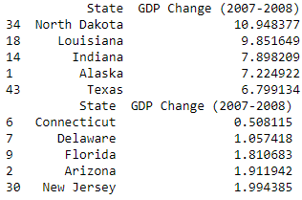
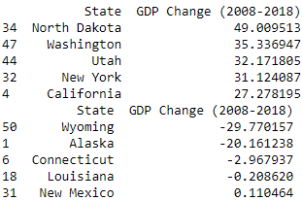
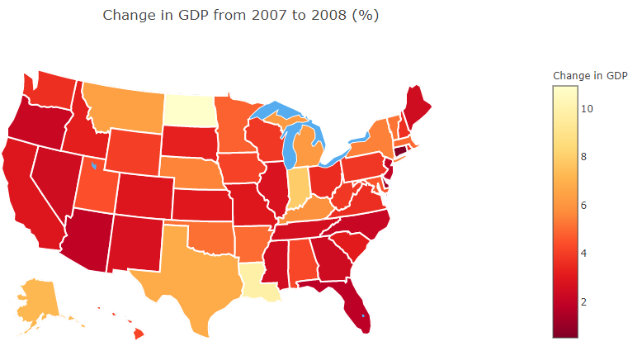
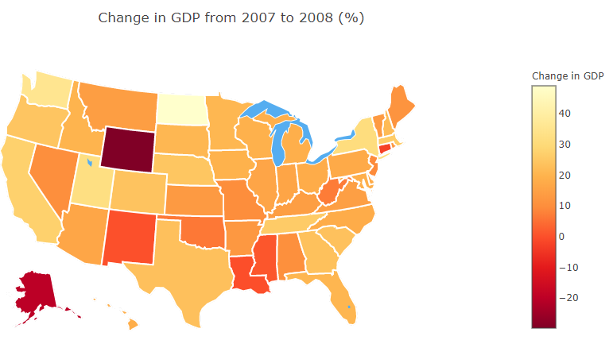
State GDP Changes

Slide 4
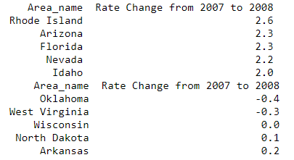
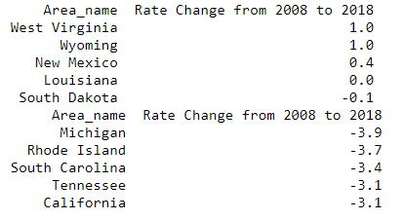
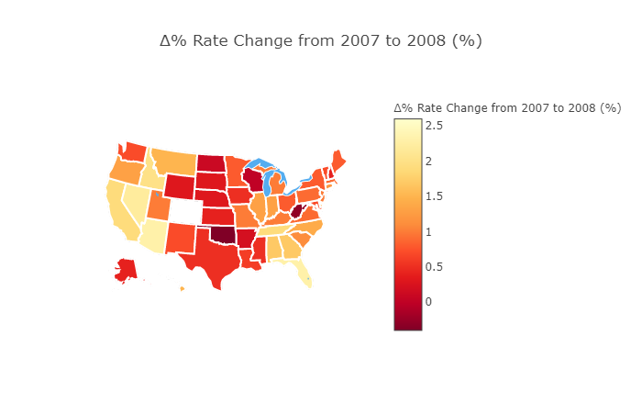
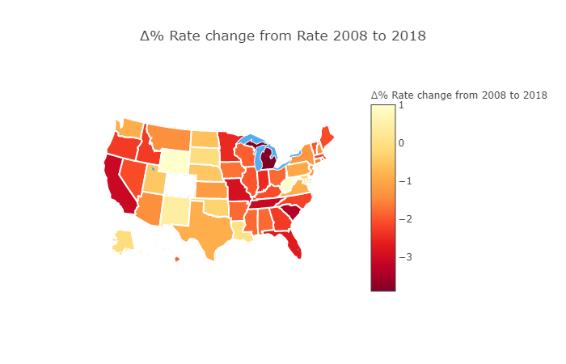
Unemployment Rate Changes
Notes:
Referring to the previous slide of state GDP we noticed a positive correlation between California’s state GDP change from 2008 to 2018 and Unemployment rate change from 2008 to 2018 as being in the top 5. I also noticed that Louisiana had very little change from 2008 to 2018 in state GDP and in unemployment change from 2008 to 2018. Another Inference that can be observed from the State GDP and the Unemployment rate changes is how Wyoming was one of the worst states that recovered from the 2008 financial crisis with a GDP decreased by 29.7% and unemployment increased by 1% since 2008 to 2018.

Slide 5
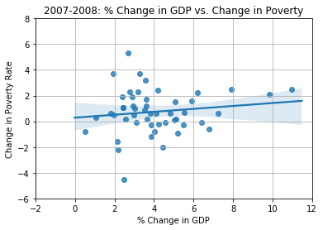
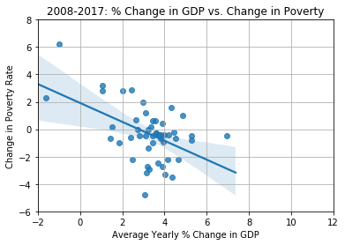
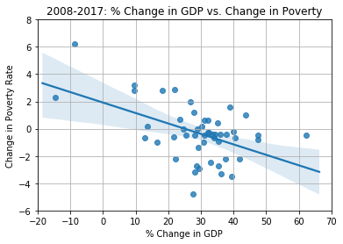
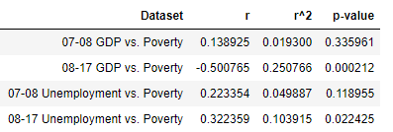
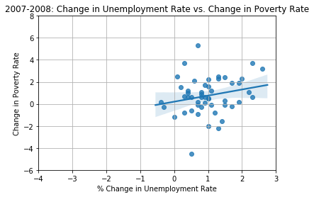
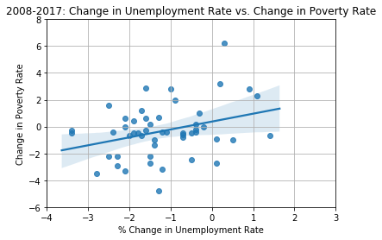
Poverty Rates vs. Changes in GDP and Unemployment Rates
Notes:
1. Expected to see consistent negative correlation between decrease in poverty rate and increase in GDP. 07-08 % change in GDP vs. change in poverty showed a low positive correlation and high p-value
indicating changes in the variables do not affect each other. 08-17 % change in GDP vs. change in poverty showed trend more in line with hypothesis: increases in GDP correlated with decreases in poverty rate. Best r^2 value
and low p-value indicating a trend is apparent, but with lots of noise/variability.
Conclusion 1: In general over the long term recovery, states that have higher increases in GDP have greater decreases in poverty rates although there is a lot variability
Interesting to note that 07-08 had all positive change in GDP while 08-17 had 2 states with large decreases in GDP. Possibly due to no recovey, changes in industry. Also possibly 07-08 gdp wasn’t fully affected, maybe 07-09 would be better indicator.
Expected to see that with higher decreases in unemployment rate would have higher decreases in poverty rates. 07-08 % change in unemployment rate vs. change in poverty rate show low positive correlation. P-value beyond 95% confidence range so not a good fit. 08-17 % change in unemployment rate vs. change in poverty rate shows a positive correlation between change in poverty rate and % change in unemployment rate. Low r2, but also low p-value suggesting model is okay to use over the long run, but has high variability.
Conclusion 2: In general over the long term recovery, states that have greater decreases in the unemployment rate have greater decreases in the poverty rate although there is a lot variability.
Interesting to note that 07-08 only 2 states had decreases in unemployment rate, but mixed range of changes in poverty rates. Also from 07-08 increases in all states unemployment rates except 2 but over long run/recovery, majority had decreases in unemployment rates

Slide 6
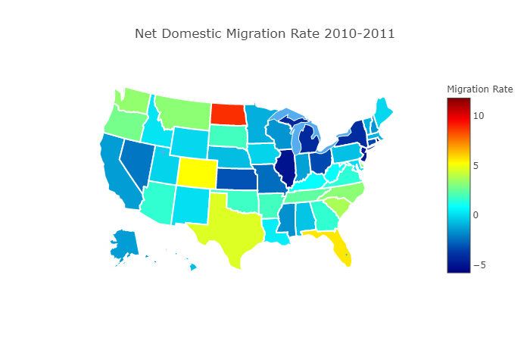
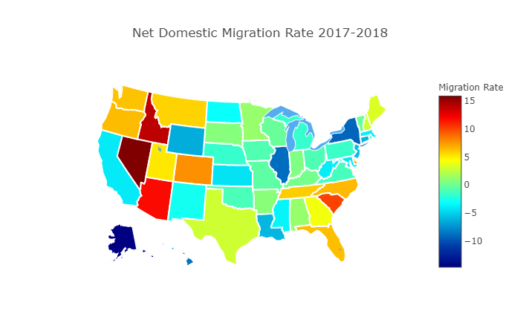
Net Domestic Migration Rate 2010-11 & 2017-18

Slide 7
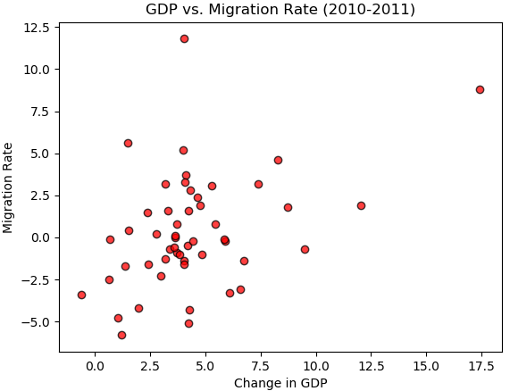
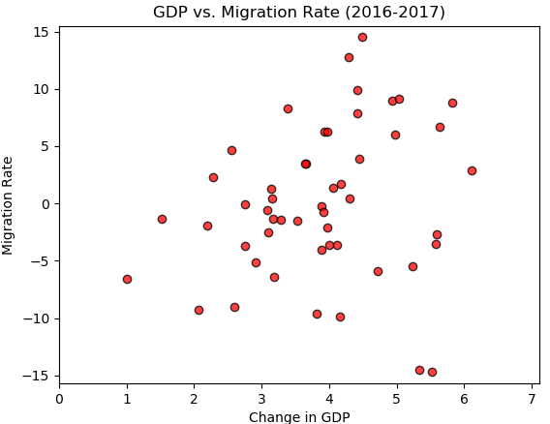
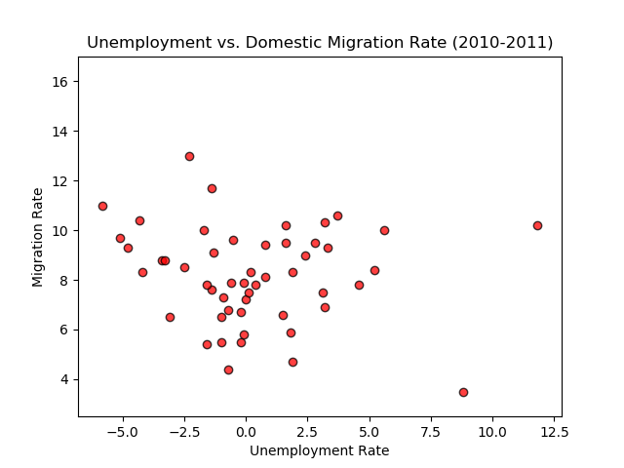
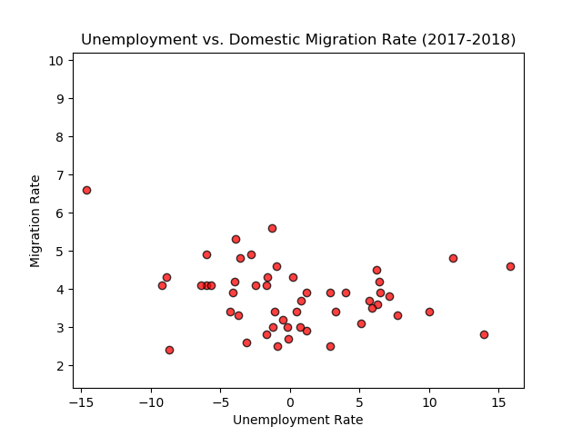
Migration Rates vs. Changes in GDP and Unemployment Rates

Slide 8
Summary
For GDP, which states survived the recession the best? Which states were impacted the hardest by the recession?
GDP Findings: 1. North Dakota was the only state that showed in the top 5 for both 07-08 and 08-18. 2. Connecticut was the only state in the bottom 5 for 07-08 that hasn't been able to rebound and finds itself in the bottom 5 for 08-18, as well.
Summarization for State Unemployment: Referring to the previous slide of state GDP we noticed a positive correlation between California’s state GDP change from 2008 to 2018 and Unemployment rate change from 2008 to 2018 as being in the top 5. I also noticed that Louisiana had very little change from 2008 to 2018 in state GDP and in unemployment change from 2008 to 2018. Another Inference that can be observed from the State GDP and the Unemployment rate changes is how Wyoming was one of the worst states that recovered from the 2008 financial crisis with a GDP decreased by 29.7% and unemployment increased by 1% since 2008 to 2018.
Which states in the United States had some of the biggest changes in net domestic migration rate between the periods of 2010-11 to 2017-18?
Alaska had an alarming drop in the net domestic migration rate from 2010-11 to 2017-18. The state went from -1.4% to -14.9. That is a 13.5% increase of the net domestic migration rate after an 8 year period
Idaho had a slightly positive migration rate of 0.2% in 2010-11 but turned that around in 2017-18 with the second highest net migration rate of that year 13.9% and the second greatest increase after that 8 year period of 13.7%
Nevada had a negative migration rate of -2.3% in 2010-11 but made the greatest increase at 18.1% and had the highest net migration rate of the 2017-18 period of 15.8%
Which states in the United States stayed the most consistent over the past 8 years?
Florida had a positive migration rate of 5.6% in 2010-11 and only had a 0.7% increase in 2017-18 to give them 6.3%
Kentucky was another state with only a 0.8% migration rate which dropped to 0.2% in 2017-18, a loss of 0.6%
Pennsylvania had an increase in migration rate after the 8 year period from -0.6% in 2010-11 to 1.6% in 2017-18, a 2.2% increase
Comparing the relationship between Unemployment Rate and Net Domestic Migration Rate in 2010-11 & 2017-18 (Scatter Plots):
The migration rate from 2010-11 to 2017-18 has dropped significantly overall. The highest peak in 2010-11 for migration rate is between 12-14% while 2017-18 is between 6-7%
With the exception of a few outliers the overall unemployment rate has spread out more. In 2010-11 the unemployment rate was generally between -5% and 6%, while in 2017-18 it was generally between -10% and 10%.
Concluding Analysis:- We can say that based on the data visualized in the presentation, there is not an obvious positive or negative trend between Unemployment rate and Domestic migration rate.
Was there any correlation between poverty changes and unemployment change and GDP change? Did states with higher positive GDP changes have decreases in poverty rates?
1. From 07-08, there were no statistically significant trends between poverty and unemployment and poverty and GDP changes.
2. From 08-17, there were significant trends specifically decreases in poverty rate correlated with increases in GDP and decreases in poverty rate correlated with decreases in unemployment rate as hypothesized, but there was a lot of variability

